Slide 1
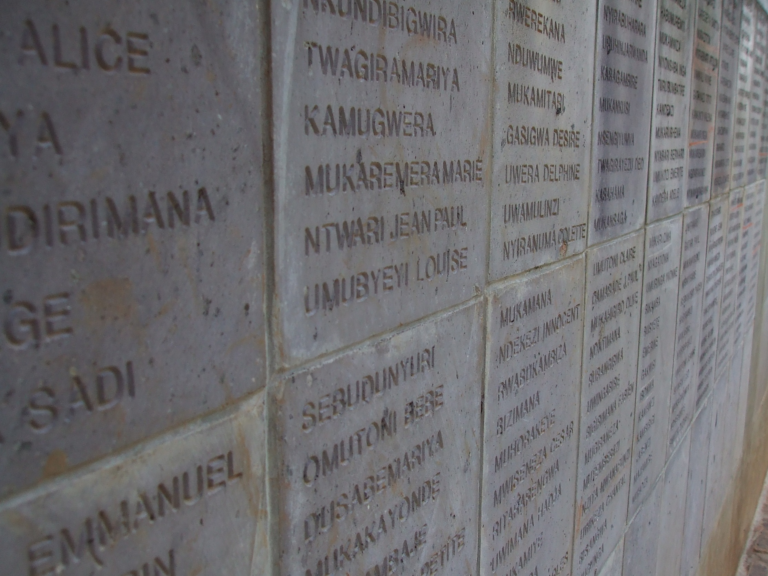
Lessons from Rwanda
The Rwandan Genocide
Lesson 2 – Hatred, propaganda and war

Slide 2
What is propaganda?
How can a government try to influence people?
When do we see propaganda in our lives?

Slide 3
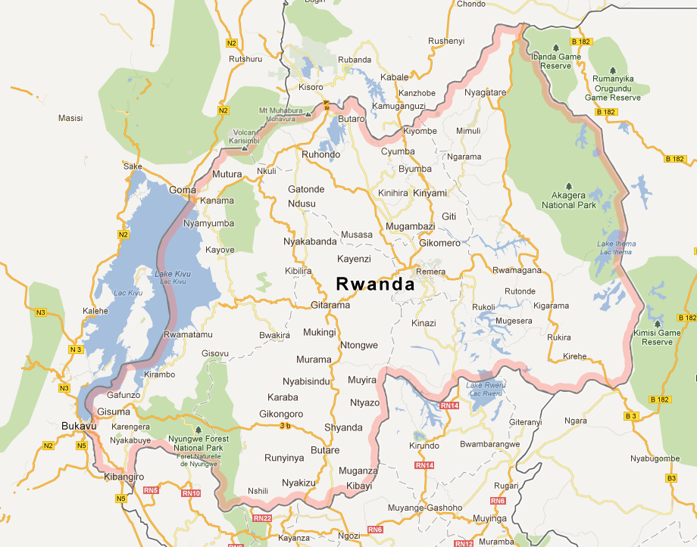
1 October 1990
RPF troops cross the Ugandan-Rwandan border and attack the Habyarimana regime. They demand an end to identity cards and ethnic persecution.
January 1991
General Paul Kagame, leader of the RPF changes tactics and pursues a campaign of guerrilla warfare.
October 1990
Troops from France and Zaire intervene and push the RPF forces back.

Slide 4
Ceasefire
A ceasefire was agreed on 12 July 1992 although tension continued to exist.
February 1993
Due to reports of genocide, the RPF launch a huge offensive and aim for Kigali, the capital city.
French Troops
February 1993
French troops intervene and a ceasefire established until 7 April 1994.

Slide 5
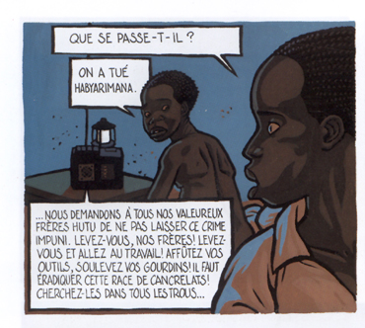
"What does it say?"
"Someone's killed Habyaramina."
We demand that our Hutu brothers do not let these crimes go unpunished. Raise yourselves, our brothers. Raise yourselves and work! Get your tools and raise your clubs! It's time to eradiate the cancer race. Look for them everywhere.

